Slide 1
Hierarchical Clustering
1

Slide 2
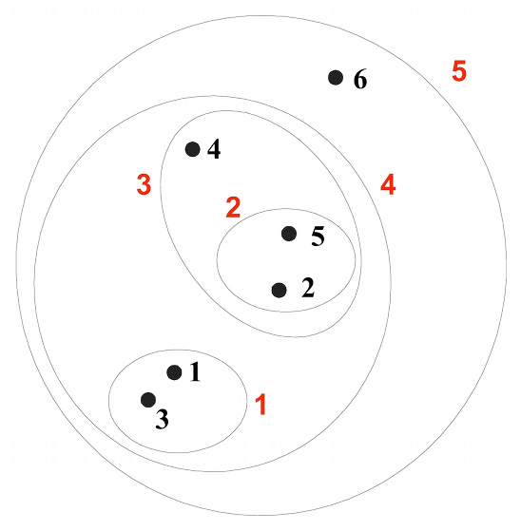
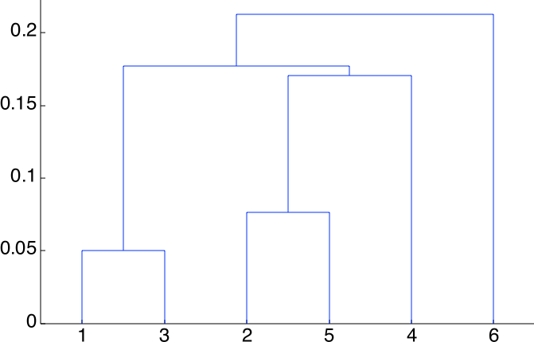
Hierarchical Clustering
Produces a set of nested clusters organized as a hierarchical tree
Can be visualized as a dendrogram
– A tree-like diagram that records the sequences of merges or splits

Slide 3
Strengths of Hierarchical Clustering
No assumptions on the number of clusters
Any desired number of clusters can be obtained by ‘cutting’ the dendogram at the proper level
Hierarchical clusterings may correspond to meaningful taxonomies
Example in biological sciences (e.g., phylogeny reconstruction, etc), web (e.g., product catalogs) etc

Slide 4
Hierarchical Clustering Algorithms
Two main types of hierarchical clustering
Agglomerative:
Start with the points as individual clusters
At each step, merge the closest pair of clusters until only one cluster (or k clusters) left
Divisive:
Start with one, all-inclusive cluster
At each step, split a cluster until each cluster contains a point (or there are k clusters)
Traditional hierarchical algorithms use a similarity or distance matrix
Merge or split one cluster at a time

Slide 5
Complexity of hierarchical clustering
Distance matrix is used for deciding which clusters to merge/split
At least quadratic in the number of data points
Not usable for large datasets

Slide 6
Agglomerative clustering algorithm
•
•
Most popular hierarchical clustering technique Basic algorithm:
Compute the distance matrix between the input data points Let each data point be a cluster
Repeat
Merge the two closest clusters Update the distance matrix
Until only a single cluster remains
Key operation is the computation of the distance between two clusters
Different definitions of the distance between clusters lead to different algorithms

Slide 7
Input/ Initial setting
Start with clusters of individual points
and a distance/proximity matrix
p1 p2 p3 p4 p5
. . .
p1
p2 p3
p4 p5
.
.
.
Distance/Proximity Matrix

Slide 8
Intermediate State
•
After some merging steps, we have some clusters
 | C1 | C2 | C3 | C4 | C5
C1
C2
C3
C4
C5
C3
C4
C1
Distance/Proximity Matrix
C2
C5

Slide 9
Intermediate State
•
Merge the two closest clusters (C2 and C5) and update the
distance matrix.
 | C1 | C2 | C3 | C4 | C5
C1
C2
C3
C4
C5
C3
C4
C1
Distance/Proximity Matrix
C2
C5

Slide 10
After Merging
•
“How do we update the distance matrix?”
C2 U
C5
 | C1 |  | C3 | C4
C1 |  | ?
C5 | ? | ? | ? | ?
C3 |  | ?
C4 |  | ?
C3
C4
C2 U
C1
C2 U C5

Slide 11
Distance between two clusters
Each cluster is a set of points
How do we define distance between two sets of points
Lots of alternatives
Not an easy task

Slide 12
Distance between two clusters
Single-link distance between clusters C_{i} and C_{j} is the minimum distance between any object in C_{i} and any object in C_{j}
The distance is defined by the two most similar objects

Slide 13

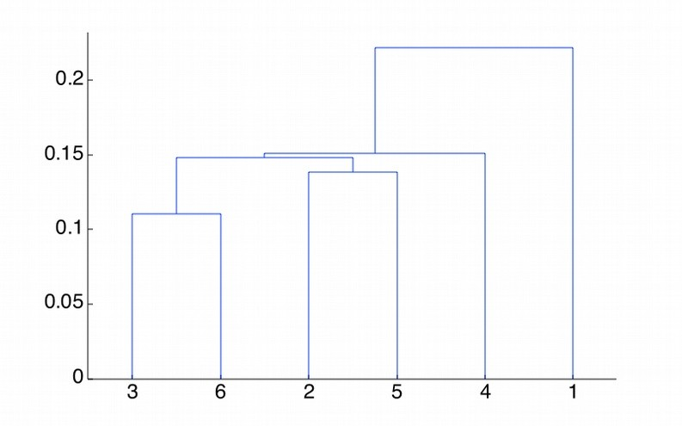





Single-link clustering: example
5
1
3
5
2
1
2
3
6
4
4
Nested Clusters
Dendrogram

Slide 14
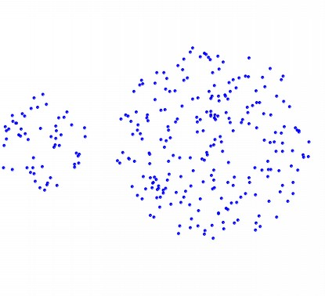
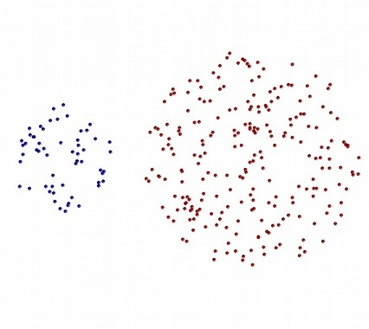
Strengths of single-link clustering
Original Points
Two Clusters
Can handle non-elliptical shapes

Slide 15
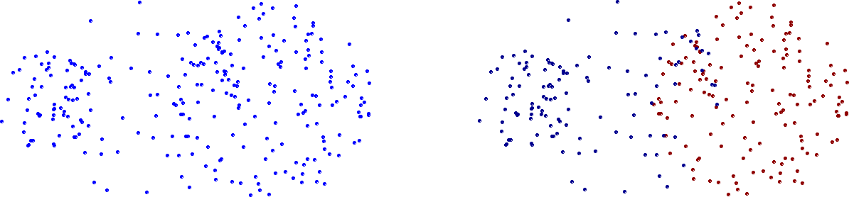
Limitations of single-link clustering
Original Points
Two Clusters
Sensitive to noise and outliers
It produces long, elongated clusters

Slide 16
Distance between two clusters
Complete-link distance between clusters C_{i} and C_{j} is the maximum distance between any object in C_{i} and any object in C_{j}
The distance is defined by the two most dissimilar objects

Slide 17

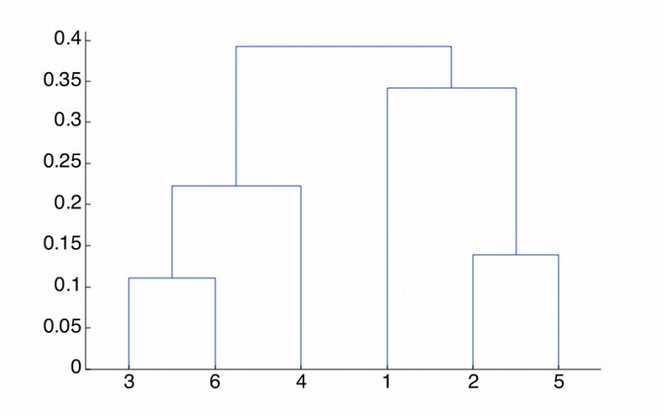





Complete-link clustering: example
4
1
2
5
5
2
3
6
3
1
4
Nested Clusters
Dendrogram

Slide 18
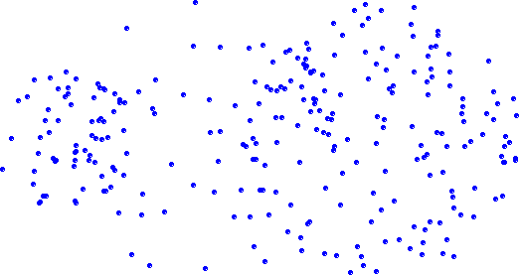
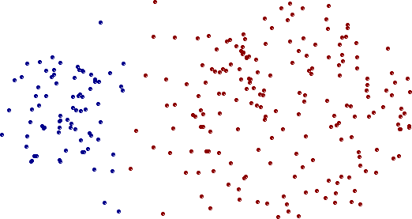
Strengths of complete-link clustering
Original Points
Two Clusters
More balanced clusters (with equal diameter)
Less susceptible to noise

Slide 19
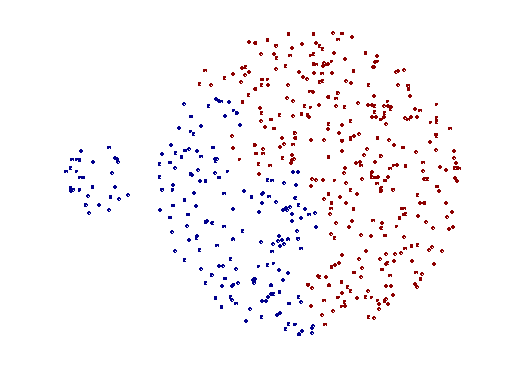
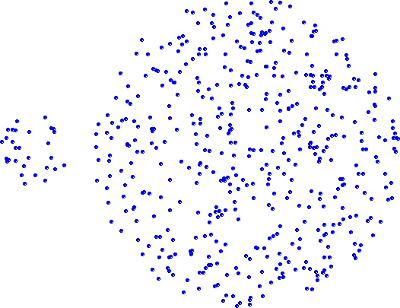
Limitations of complete-link clustering
Original Points
Two Clusters
Tends to break large clusters
All clusters tend to have the same diameter – small clusters are merged with larger ones

Slide 20

Distance between two clusters
Group average distance between clusters C_{i} and C_{j} is the average distance between any object in C_{i} and any object in C_{j}

Slide 21
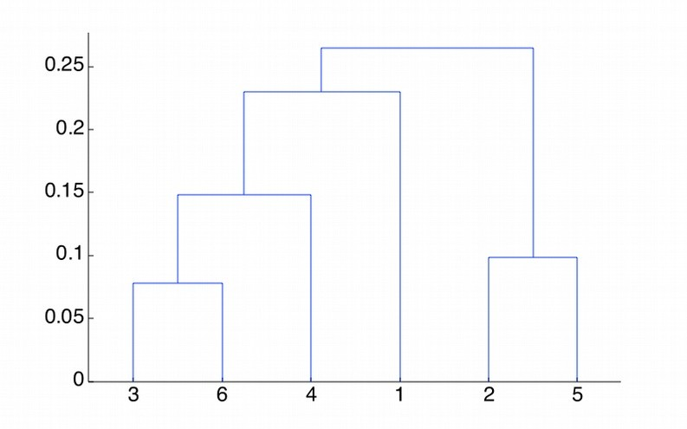
Average-link clustering: example
5
4
1
2
5
2
3
6
1
4
3
Nested Clusters
Dendrogram

Slide 22
Average-link clustering: discussion
•
Compromise between Single and Complete Link
•
Strengths
– Less susceptible to noise and outliers
•
Limitations
– Biased towards globular clusters

Slide 23
Hierarchical Clustering: Time and Space requirements
For a dataset X consisting of n points
O(n²) space; it requires storing the distance matrix
O(n³) time in most of the cases
There are n steps and at each step the size n² distance matrix must be updated and searched
Complexity can be reduced to O(n² log(n) ) time for some approaches by using appropriate data structures

